Slide 1


Rajan Topiwala
30 May 2023

Slide 2

Outline
Executive Summary
Introduction
Methodology
Results
Conclusion
Appendix

Slide 3
Executive Summary
Summary of methodologies
Data Collection: API & Web Scraping
Data Wrangling
Data Exploration with SQL and Data Visualization with Python
Interactive Visual Analytics with Folium
Predictive Analytics with Python
Summary of all results
Visualizations
Interactive Map
Machine Learning Accuracies

Slide 4
Introduction
Space X is a company disrupting the space industry offering the cheapest rocket launches for various clients. Cost-savings from using cheaper materials, and the concept of a reusable rocket allow them to drive prices down.
The goal is to predict future landing outcomes of the first stage of launch:
Model the factors that influence landing outcome
Control for relationships between variables
Find the best conditions to minimize risk

Slide 5

Section 1

Slide 6
Methodology
Executive Summary
Data collection methodology:
SpaceX Rest API and web scraping from Wikipedia
Perform data wrangling
Using one-hot encoding for categorical features (replacing nulls with means, cleaning etc.)
Perform exploratory data analysis (EDA) using visualization and SQL
Perform interactive visual analytics using Folium and Plotly Dash
Perform predictive analysis using classification models
Building, tuning, evaluating various classification models

Slide 7
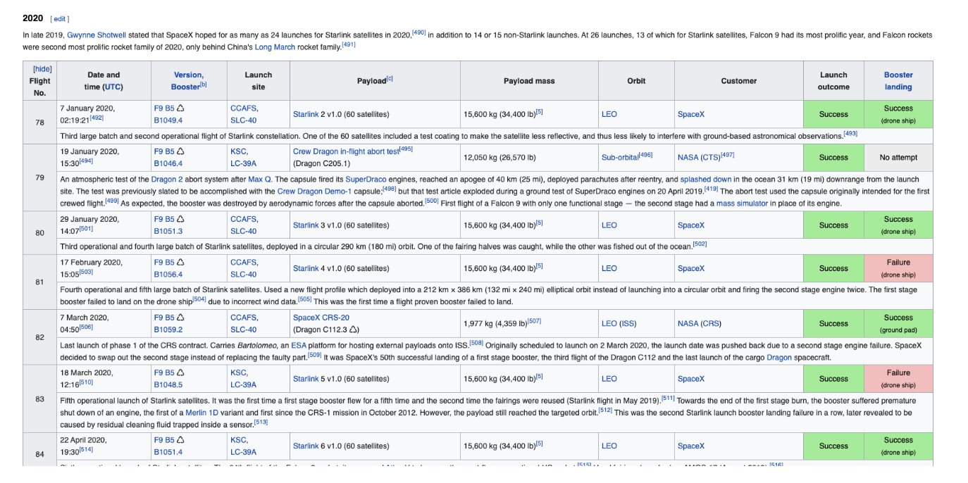
Data Collection
REST API
Requests package
Convert Json to pandas dataframe
Wikipedia Page
Parse HTML Table and convert to pandas dataframe

Slide 8
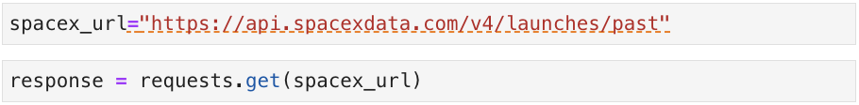
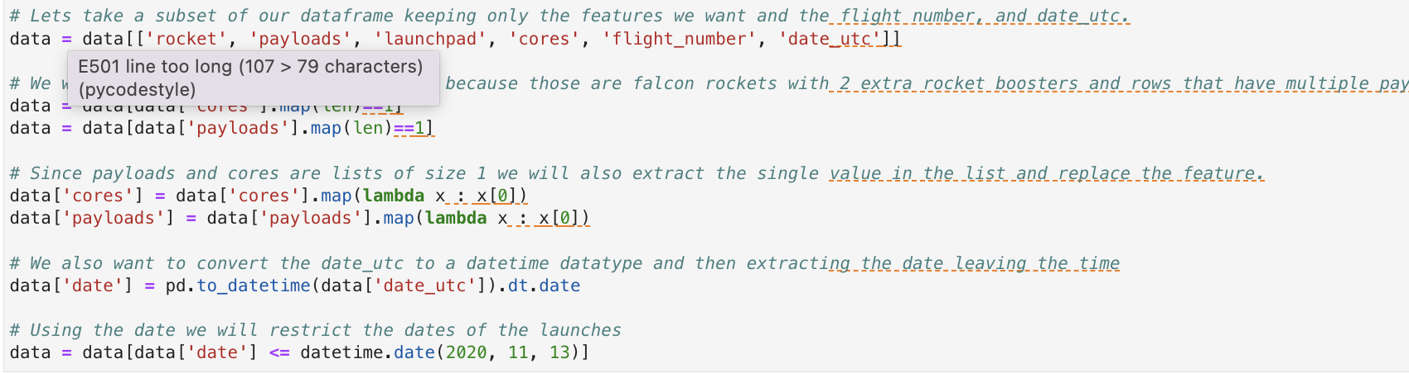
Data Collection – SpaceX API
1. Get Request
2. Convert JSON to pd.dataframe
3. Clean Data
Github URL: https://github.com/rajantopiwala/Capstone-IBM-Certificate/blob/main/jupyter-labs-spacex-data-collection-api.ipynb

Slide 9
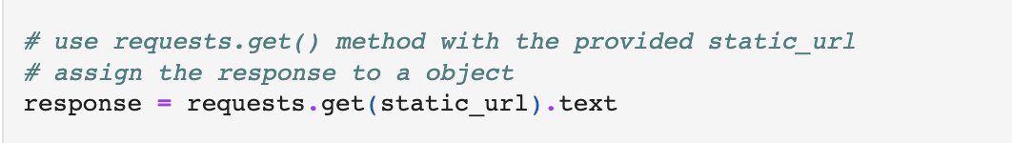
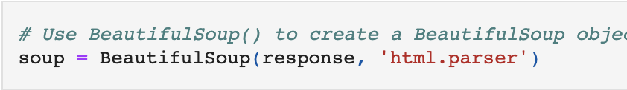
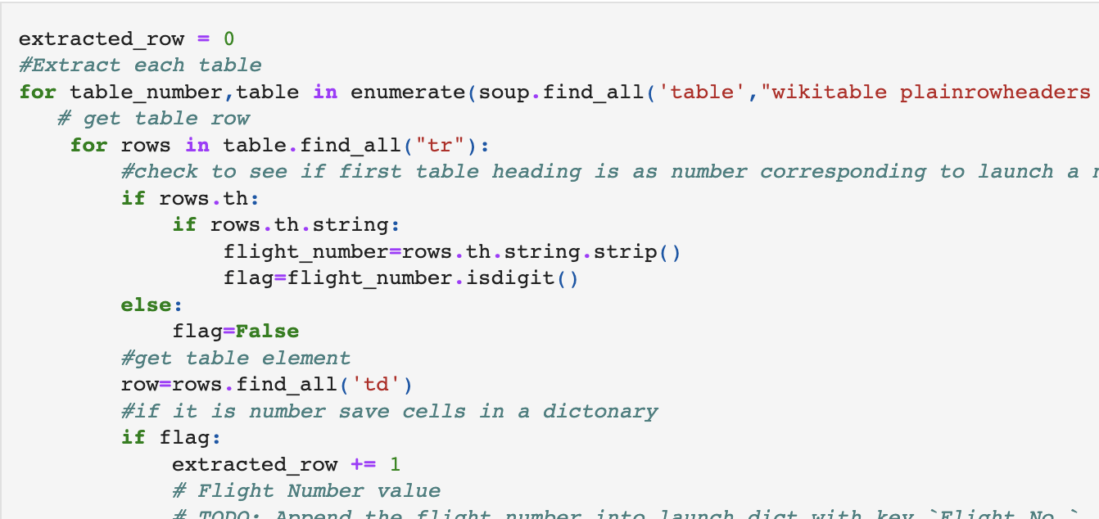
Data Collection - Scraping
1. Get Request to URL of Wikipedia Page
2. Beautiful Soup to parse HTML table
3. Extract columns and values
Github URL: https://github.com/rajantopiwala/Capstone-IBM-Certificate/blob/main/jupyter-labs-webscraping.ipynb

Slide 10
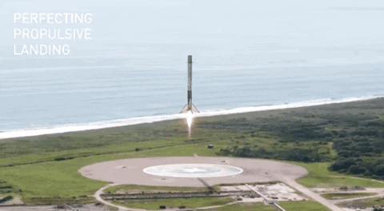
Data Wrangling
Perform some Exploratory Data Analysis (EDA) to find some patterns in the data and determine what would be the label for training supervised models

Slide 11
EDA with Data Visualization
Scatter Plots: patterns to find features that determine success rate
Payload vs Flight Number
Flight Number vs Launch Site
Flight Number vs. Orbit Type
Payload vs Orbit Type
Bar/Line Plot:
Success by Orbit type and Year
Github URL: https://github.com/rajantopiwala/Capstone-IBM-Certificate/blob/main/IBM-DS0321EN-SkillsNetwork_labs_module_2_jupyter-labs-eda-dataviz.ipynb.jupyterlite.ipynb

Slide 12
EDA with SQL
Display names of launch sites
Display rows where launch site begins with ‘CCA’
Display Total payload mass carried by NASA
Display average payload mass carried by booster version F9 v1.1
List date of first successful landing outcome in ground pad
List names of boosters which have success in drone ship and payload mass between 4000 and 6000
List total number of successful and failure mission outcomes
List name of booster versions that have carried max payload mass
List the records which will display the month names, failure landing_outcomes in drone ship ,booster versions, launch_site for the months in year 2015.
Rank the count of successful landing_outcomes between the date 04-06-2010 and 20-03-2017 in descending order.
Github URL: https://github.com/rajantopiwala/Capstone-IBM-Certificate/blob/main/jupyter-labs-eda-sql-coursera_sqllite.ipynb

Slide 13
Build an Interactive Map with Folium
Launch success may depend on location and proximities of launch site – initial position on rocket trajectories
Goal: to find the optimal location
On a folium map:
Coordinates of each launch site and marker with the name of the launch site
Then use distance formula to calculate distance of launch sites to various landmarks (highways, railways, and coastlines (to notice any patterns)
Github URL: https://github.com/rajantopiwala/Capstone-IBM-Certificate/blob/main/IBM-DS0321EN-SkillsNetwork_labs_module_3_lab_jupyter_launch_site_location.jupyterlite.ipynb

Slide 14
Build a Dashboard with Plotly Dash
Interactive Dashboard showing the success rate of launches at each launch site (or all) in a pie chart
Scatter graph of Success Rate (landing outcome) and Payload mass for each different booster version
Github URL: https://github.com/rajantopiwala/Capstone-IBM-Certificate/blob/main/spacex_dash_app.py

Slide 15
Predictive Analysis (Classification)
Building Model
Load dataset and set parameters and algorithms to GridSearchCV
Evaluating Model
Find Accuracy Scores for each model, plot Confusion Matrix,
Tuning Model
Result: Best Model
Choose model with best accuracy Score
Github URL: https://github.com/rajantopiwala/Capstone-IBM-Certificate/blob/main/IBM-DS0321EN-SkillsNetwork_labs_module_4_SpaceX_Machine_Learning_Prediction_Part_5.jupyterlite.ipynb

Slide 16
Results
Exploratory data analysis results
Interactive analytics demo in screenshots
Predictive analysis results

Slide 17

Section 2

Slide 18
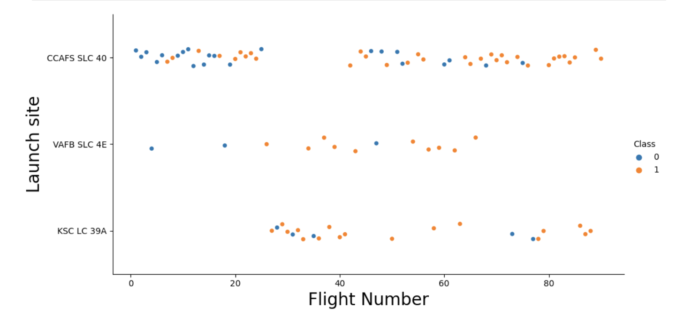
Flight Number vs. Launch Site

Slide 19
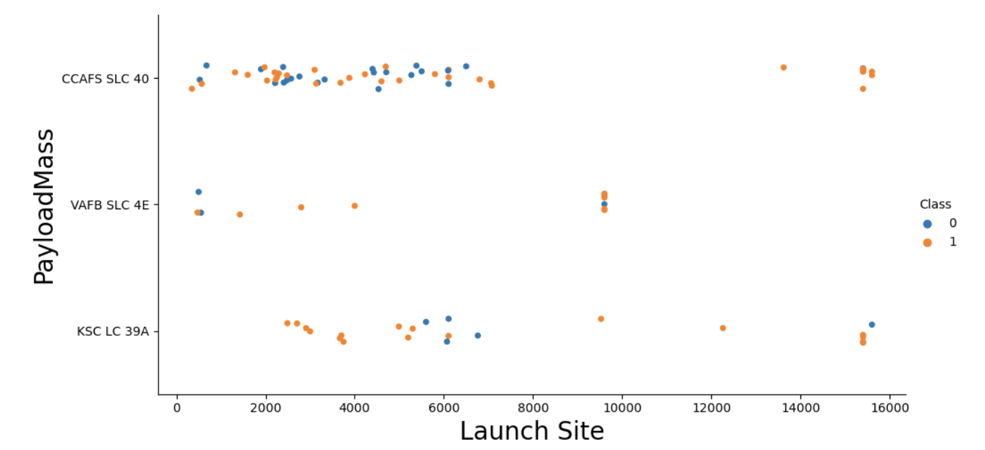
Payload vs. Launch Site
For the VAFB-SLC launchsite there are no rockets launched for heavypayload mass (greater than 10000).

Slide 20
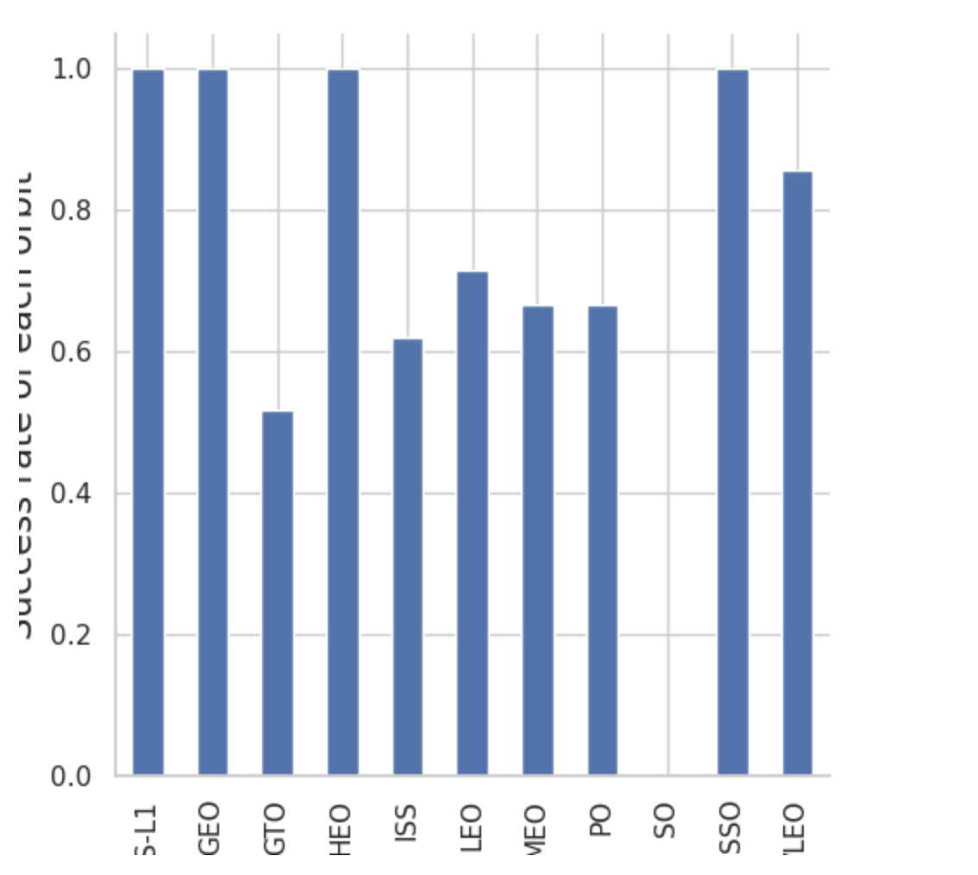
Success Rate vs. Orbit Type

Slide 21
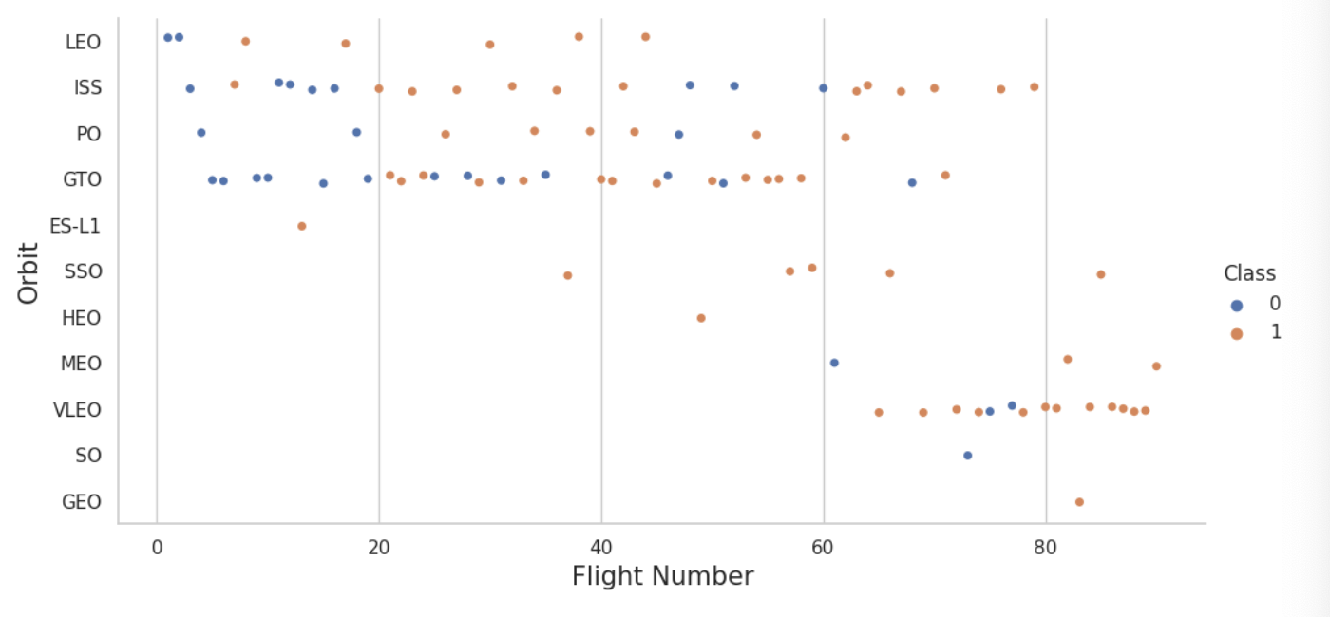
Flight Number vs. Orbit Type
In the LEO orbit the Success appears related to the number of flights; on the other hand, there seems to be no relationship between flight number when in GTO orbit.

Slide 22
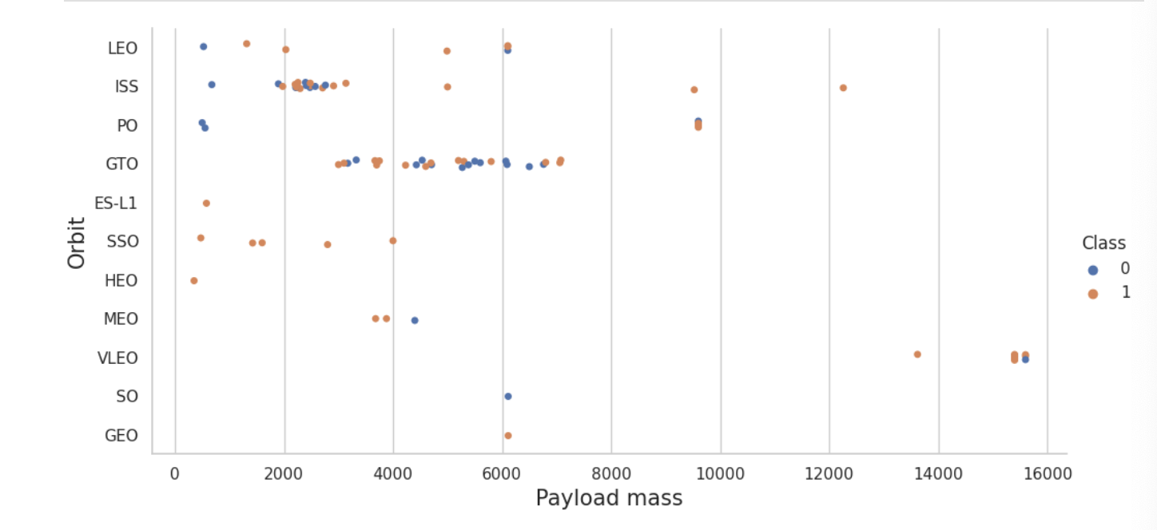
Payload vs. Orbit Type
With heavy payloads the successful landing or positive landing rate are more for Polar, LEO and ISS.

Slide 23
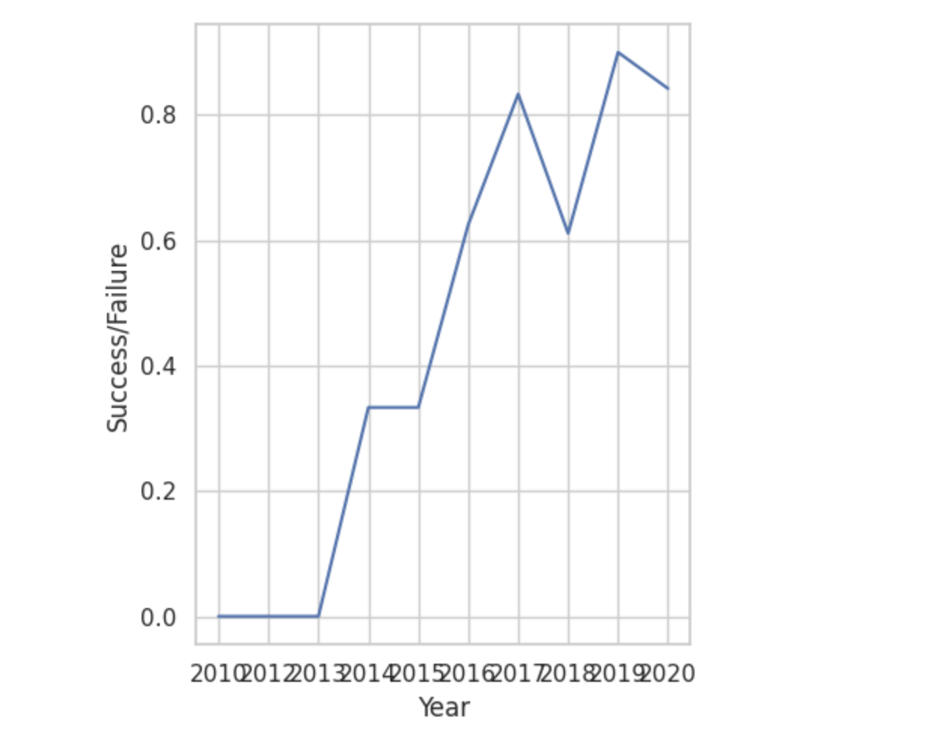
Launch Success Yearly Trend
Success Rate since 2013 kept increasing until 2020

Slide 24
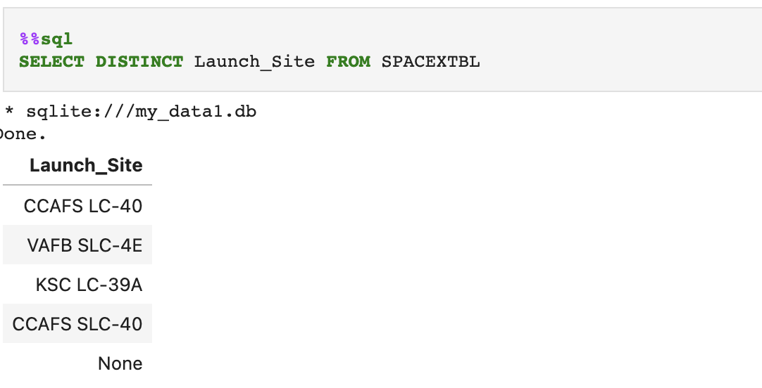
All Launch Site Names

Slide 25
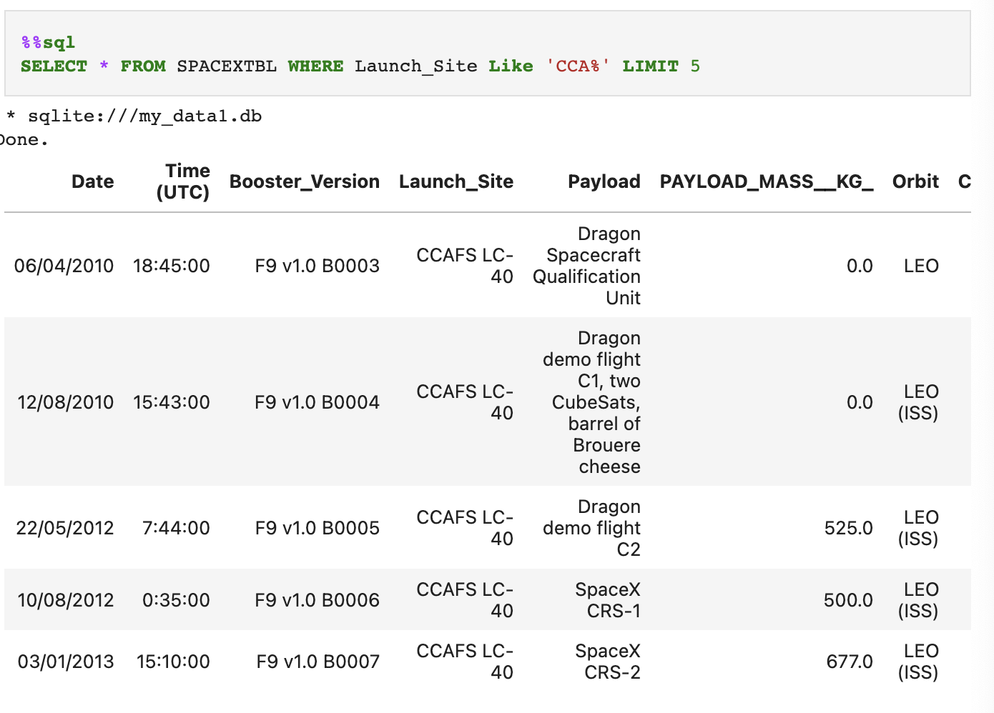
Launch Site Names Begin with 'CCA'

Slide 26
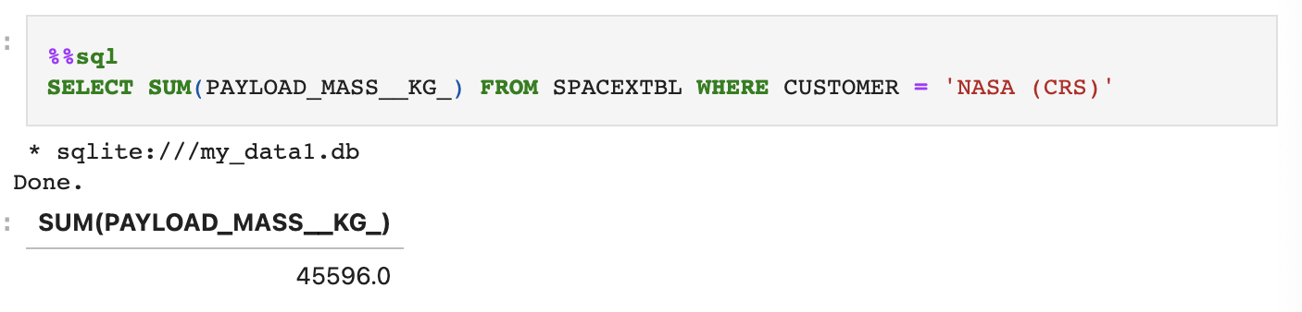
Total Payload Mass

Slide 27
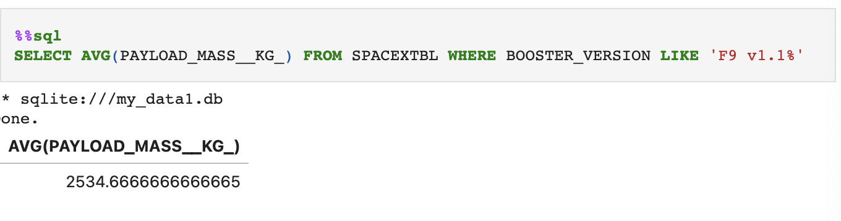
Average Payload Mass by F9 v1.1

Slide 28
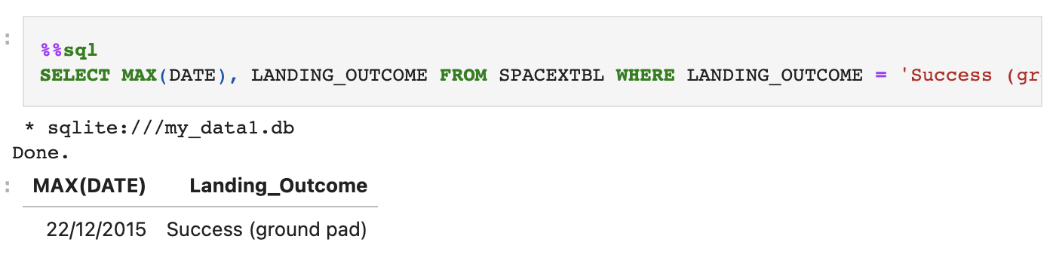
First Successful Ground Landing Date

Slide 29
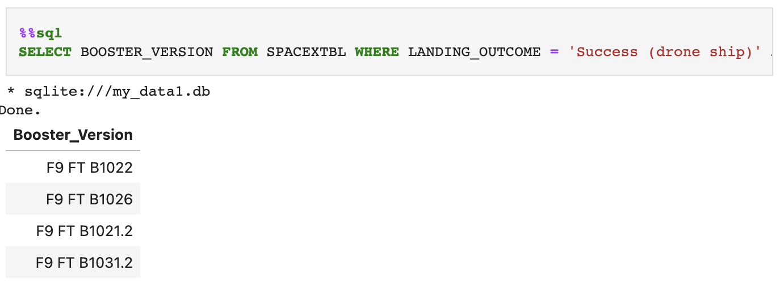
Successful Drone Ship Landing with Payload between 4000 and 6000

Slide 30
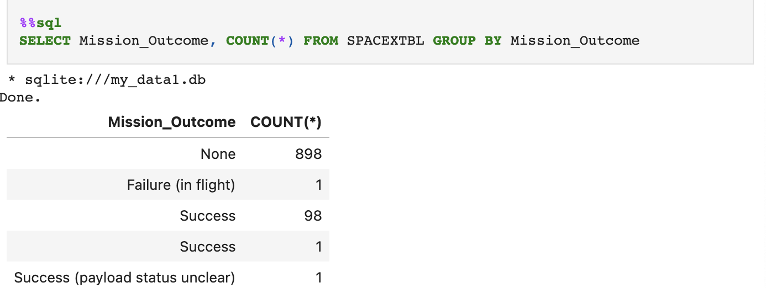
Total Number of Successful and Failure Mission Outcomes

Slide 31
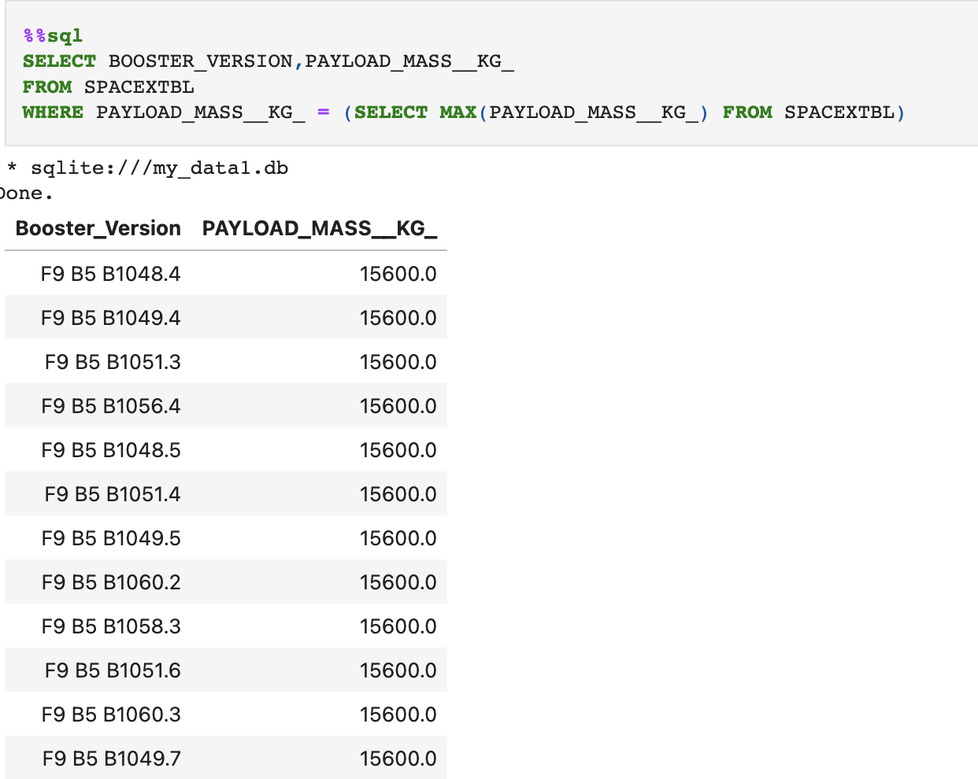
Boosters Carried Maximum Payload

Slide 32
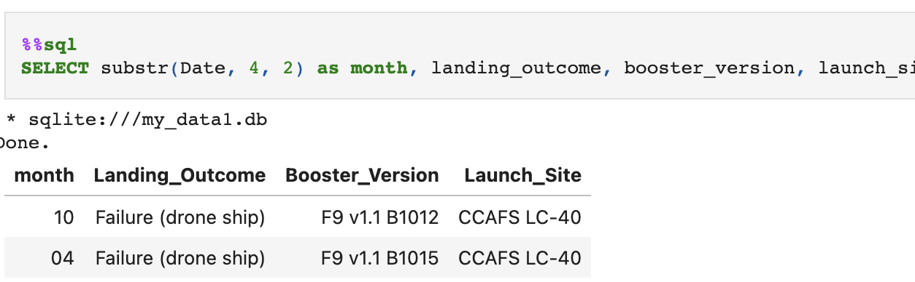
2015 Launch Records

Slide 33
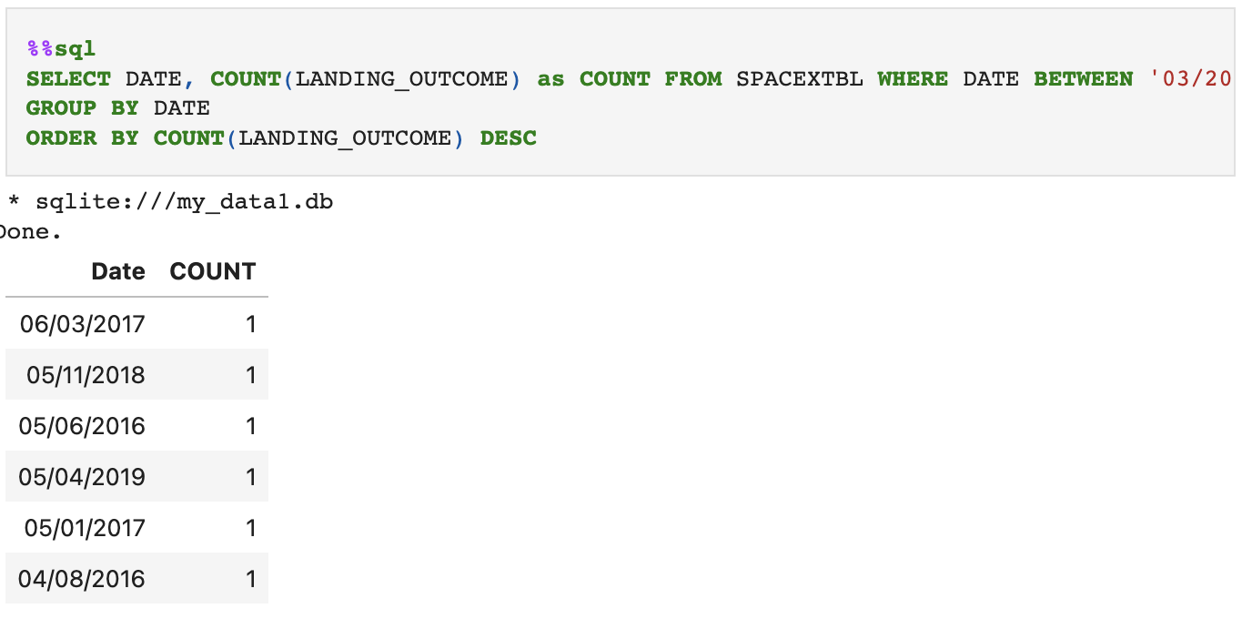
Rank Landing Outcomes Between 2010-06-04 and 2017-03-20

Slide 34

Section 3

Slide 35
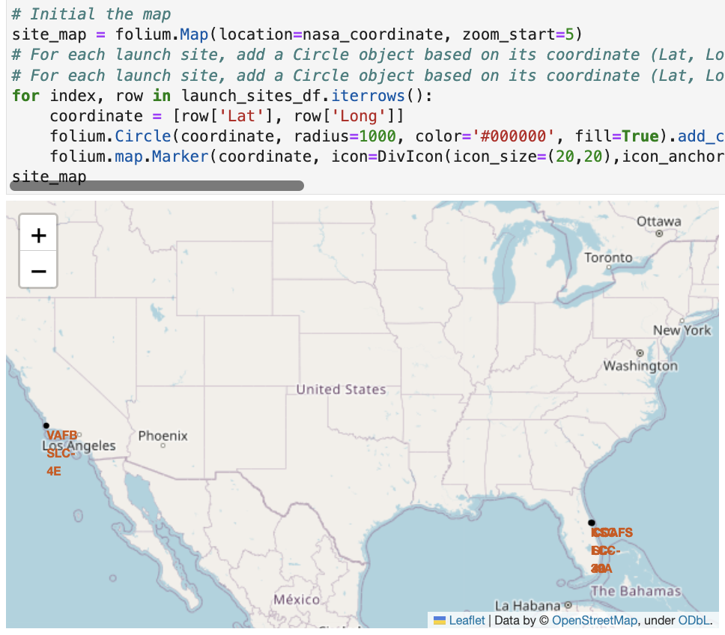
Folium Map Plotting all Launch Sites

Slide 36
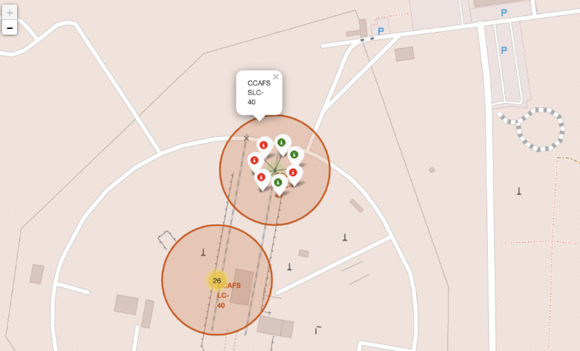
Folium launch sites with color labels

Slide 37
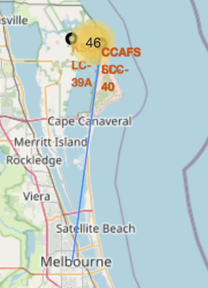
Folium Map with Proximities
Are launch sites in close proximity to railways? Yes – transport
Are launch sites in close proximity to highways? Yes – transport
Are launch sites in close proximity to coastline? Yes – transport
Do launch sites keep certain distance away from cities? Yes - minimize damage to populated areas

Slide 38

Section 4

Slide 39
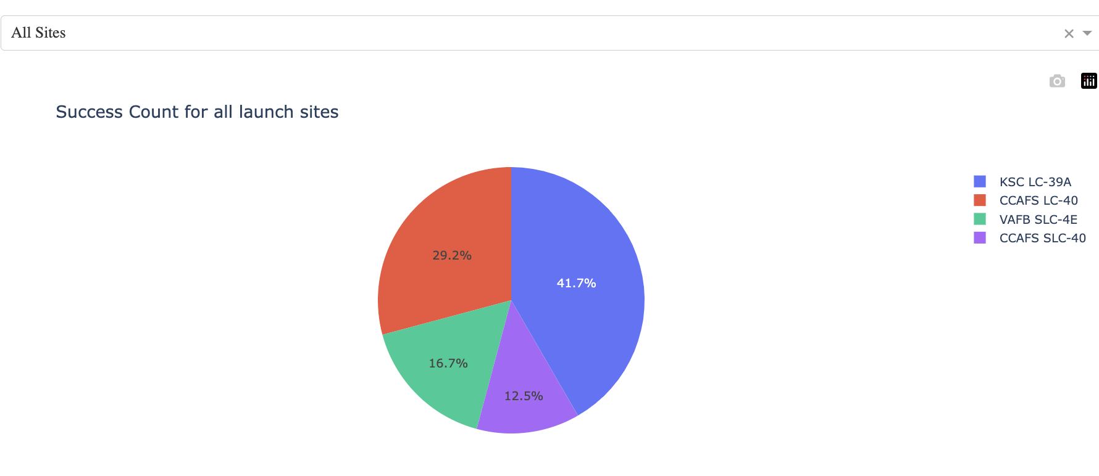
Pie Chart: Success Rate of all Launch Sites

Slide 40
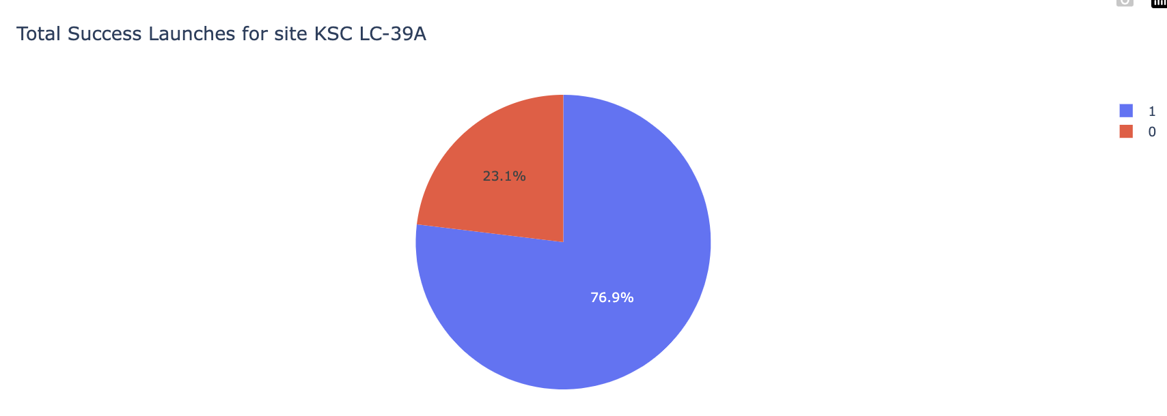
Pie Chart of Launch Site with Highest Success Ratio

Slide 41
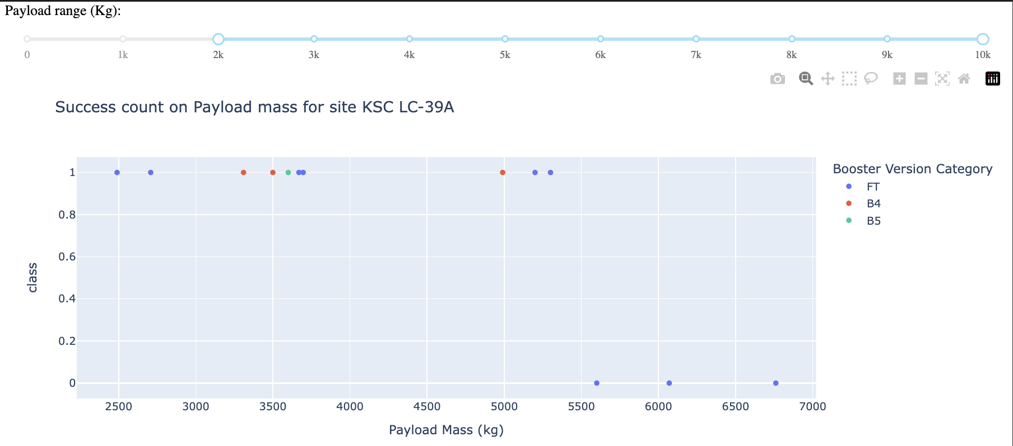
Scatter Plot: Payload vs Launch outcome
Success Rate for low-weighted payload is higher: this is an intuitive finding

Slide 42

Section 5

Slide 43
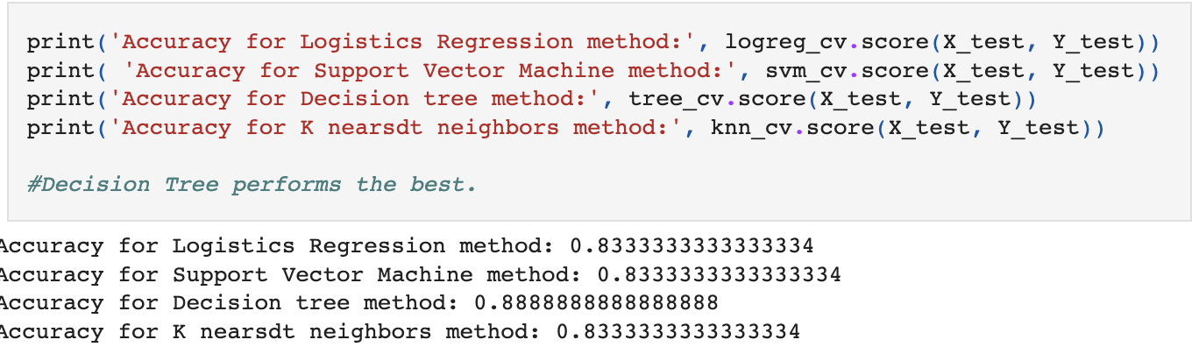
Classification Accuracy
Visualize the built model accuracy for all built classification models, in a bar chart
Find which model has the highest classification accuracy

Slide 44
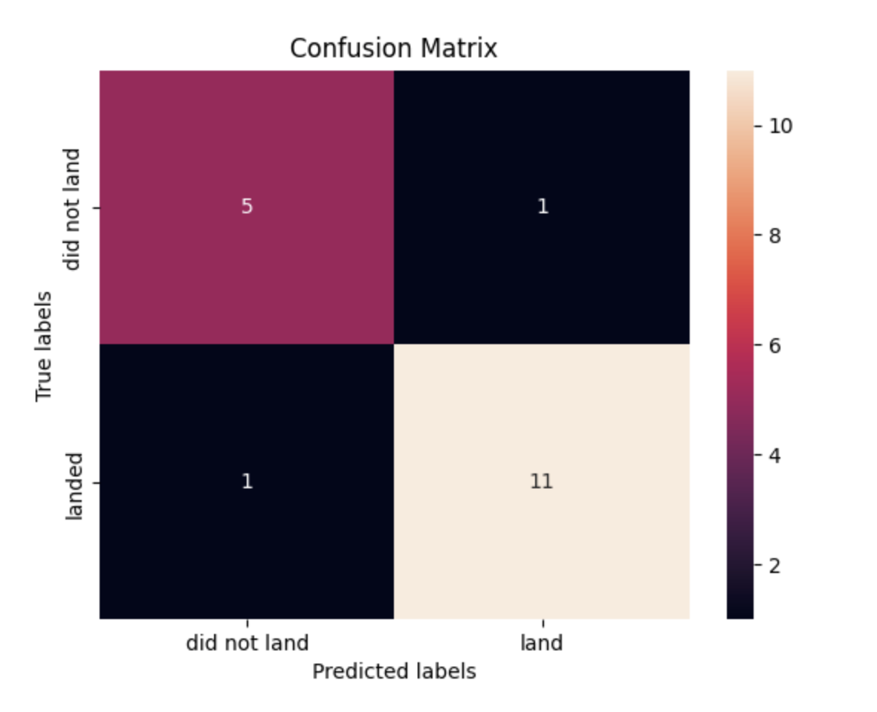
Confusion Matrix
Classifer can distinguish between the different classes

Slide 45
Conclusions
The Tree Classifier is the best Machine Learning Algorithm on the SpaceX dataset
Low weighted payloads tend to be more successful than higher weighted payloads
The KSC LC-39A launch site has the most successful launches

Slide 46


